Slide 1
STAT3013 Project: Childhood Brain Cancer in Florida: A Bayesian Clustering Approach
Mikkel Mertz, James Bailie, and Anthony Cozens
Notes:
(Maybe change times I have written ‘the articles says…’ to ‘the statisticians said…’)

Slide 2
Scientific Question
The scientific question is:
To check the robustness of the findings of another publication that there exists “putative clusters of pediatric brain cancer at zip code aggregation level in the U.S. state of Florida” and, “in particular, the raised incidence of pediatric brain cancer was found in the southern area of the state (south Florida cluster)”.
Notes:
Type of clustering is non-focussed, where they assume no previous knowledge of clusters, and prefer a flexible, lowly parameterized model.
2 different natures of clustering, hot spots and clusters.

Slide 3
The data
The data was taken from the Florida Association of Paediatric Tumour Programs.
The structure of the data is population of 0-19 year olds, and all recorded brain cancers during that period, split into the Florida zip code areas.
The data is for the years 2000-2010
There are a 983 zip code areas, with 451 areas with zero cases recorded.
Notes:
Interesting that the do not include any possible covariates – for example socio-economic, environmental factors.

Slide 4

Assumptions
The article assumes that the case counts are independently distributed Poisson variates, that is, y_{i}∼ Poisson(μ_{i} ), and μ_{i} =e_{i}θ_{i}.
y_{i} is the number of cases within the ith area,
e_{i} is the expected number of cases in the ith area,
θ_{i} is a relative risk parameter for the ith area,
and y_{i}^{p} is the population of the ith area during the time period.
The article then used 3 different models to model the θ_{i}’s and tested whether their models fitted the data.
Notes:
(The sums in ei are over all of the zip code areas)
The models:
The Standarised morbidity ratio (SMR)(i.e the MLE)
The Besag, York, and Mollie model (BYM)
The Sparse Poisson Convolution (SPC)

Slide 5
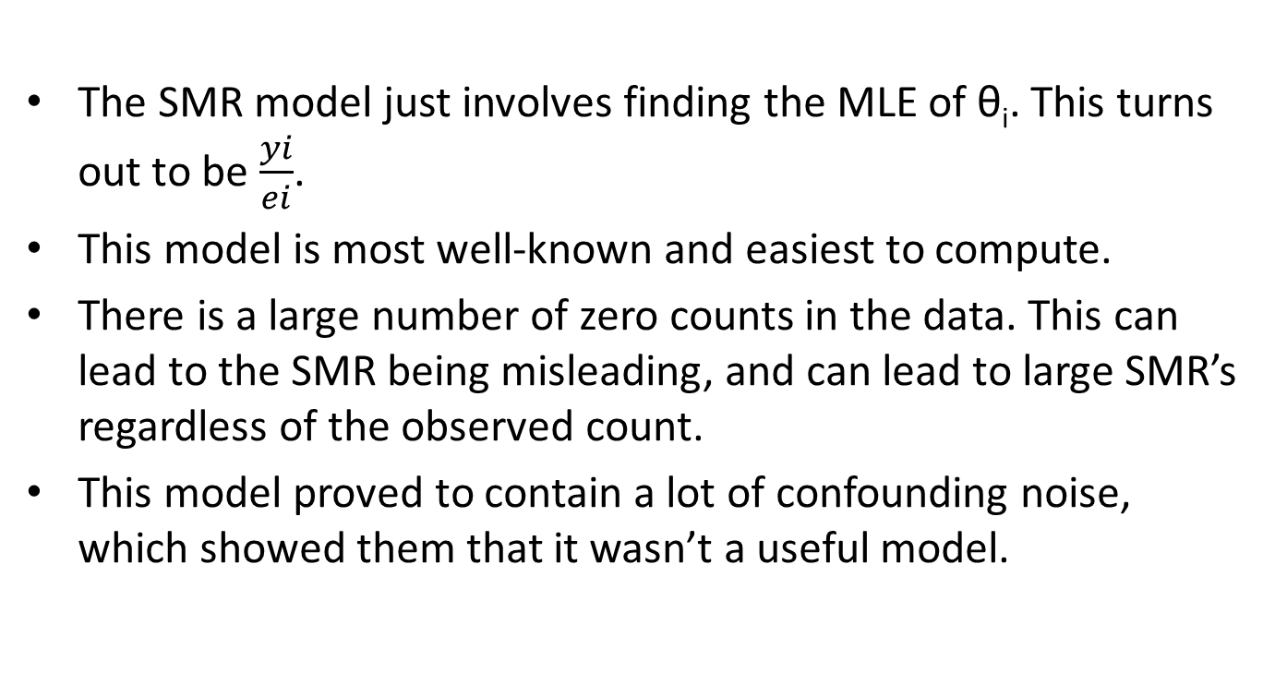
The SMR Model
The SMR model just involves finding the MLE of θ_{i}. This turns out to be $\frac{yi}{ei}$.
This model is most well-known and easiest to compute.
There is a large number of zero counts in the data. This can lead to the SMR being misleading, and can lead to large SMR’s regardless of the observed count.
This model proved to contain a lot of confounding noise, which showed them that it wasn’t a useful model.
Notes:
Simplest of the models, but doesn’t work with the large number of zero counts in the data.
It can, however, be used to obtain an explanatory view of how clusters distribute over the study area.

Slide 6
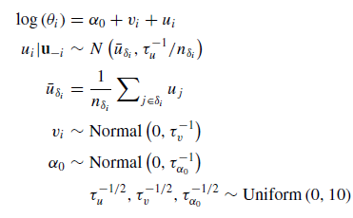
The BYM Model
The BYM model is a Bayesian approach to fitting θ_{i}. The model decomposes the log of θ_{i} into the sum of two random effects: v_{i}, which is the unstructured component, and u_{i}, which is the spatially structured component, which is dependent on the values of its neighbouring zipcodes.
The BYM Model
Notes:
“The model decomposes the log of area-level relative risks into the sum of two random effects: one which is unstructured (heterogeneous), v_{i} , and the other spatially structured (dependent), u_{i}.”
“The spatially structured effects are modeled by the intrinsic conditional autoregressive normal (ICAR) prior distribution.”
“In simple formulation, the prior distribution can be specified as the conditional distribution of each area-specific spatially structured effect, given all other spatial effects, and is a normal distribution with mean equal to the average of its neighbors, and precision proportional to the number of these neighbors.”
“The neighborhood set for the ith area is δ_{i} and the number of neighbors is n_{δi}.”
“This model has been shown in many studiesto yield robust estimates across of range of scenarios, including clustering of disease”

Slide 7
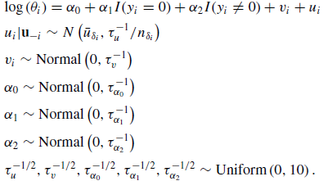
The SPC Model
The SPC Model
The SPC model is the BYM model with an indicator variable added in for whether the data value is zero or not. They have included this in the model, as zero counts in the data can be a problem since they are modelling it with a poisson distribution.
Notes:
“Since childhood cancer is a rare disease, there are zip code areas with no cases. This sparseness of the count outcomes can be a problem as the Poisson data level model might not be able to model the situation where there can be multimodality in the marginal count distribution.”
They did consider using a zero-inflated Poisson (ZIP) model, but they decided to go for the simpler approach of having the zero counts have a different intercept.
They used Monte-Carlo Markov Chain sampling, with a sample size of 10000. The Brooks-Gelman-Rubin diagnostic (Brooks and Gelman 1998) was used to check convergence.

Slide 8
Model Checking
The article uses several different ways to check and compare the two main models, the BYM and SPC models.
The deviance information criterion (DIC) is:
The exceedance probability is:
is the average deviance over the sample
Notes:
The model checking procedures in the article are more about model comparing, as there are no cut-offs mentioned in the results or model evaluation sections, and in the results they only compare the structure of the results or compare the two different models values.
With these different model checking and comparing procedures, the lower value produced, the better the model is.
“A measure of goodness-of-fit that is widely used in Bayesian modeling is the deviance information criterion (DIC)”
The exceedance probability is used to find clusters, or hot spots in the relative risk of brain cancer.
To measure the predictive capability of a model, they used the mean squared predictive error, which compares the observed data to the predicted data from the fitted model.
The deviance information criterion is an overall goodness of fit test. To investigate localised behaviour they used an exceedance probability. To measure the predictive capability of the models they used the mean square predictive error. WAIC is an alternative to the DIC, and improves on some of the problems that it has, like that DIC is not fully bayesian.
G is the sampler sample size (in the MCMC), in this article 10000

Slide 9
Model Checking
The mean square predictive error (MSPE) is:
The Watanbe-Akaike information criterion (WAIC) is:

Slide 10
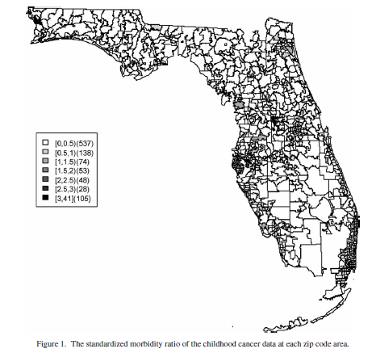
Results
Notes:
These maps show the different models values of the relative risk of cancer in each of the zip code areas.
“In the SMR map, we can see aggregated risks in the middle of the state and some apparent hot spots scattered over the northeast and along the coasts”
In the BYM map we can still see the cluster in the north east and a clustering in the middle of the state and more hotspots along the coastal areas and north and also quite a few more with a relative risk of greater than one.
In the SPC map we can still see the cluster in the north east and a clustering in the middle of the state and more hotspots along the coastal areas and north and also quite a few more with a relative risk of greater than one, quite a few more than the BYM map..

Slide 11
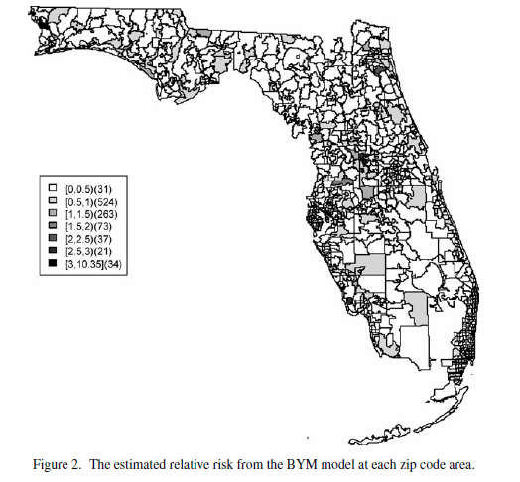
Results

Slide 12
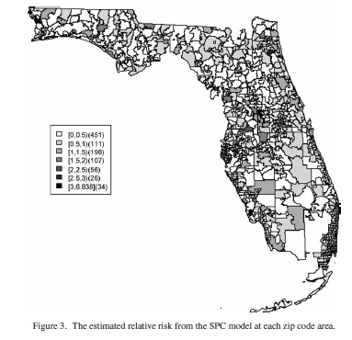
Results

Slide 13
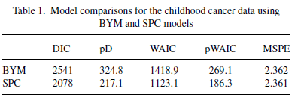
Results of the article
When they compared the BYM and SPC models, they found that the SPC is a better fit to the data, but is only marginally better at predicting future data.
They also compared the SMR with the BYM and SPC models, and found that the BYM and SPC produced smoother risk estimates
Notes:
They didn’t do all of the extra tests for the SMR model, only slightly compared it. BYM produces a smoother pattern of risks than the SPC model.
The SPC model is better than the BYM model by a decent amount, besides the MSPE, in which there are basically the same.

Slide 14
Extension – Immunisation Rates in Australia
Are there clustering of high unimmunised children in Australia?
Vaccination rates need to continue to improve to reach the 95% coverage goal for herd immunity (reference).
Outbreaks of measles linked to low vaccination rates (reference).
Notes:
Paper did not provide the data or code.
As our extension, we looked at immunisation rates of children in Australia at the postcode level. We wanted to know if there was evidence of spatial clustering of high unimmunised children.
Why is this important?
We need to continue to improve vaccination rates in Australia to reach the 95% coverage goal. The 95% level is touted as providing herd immunity which is important to prevent the spread of disease and protect at risk groups that are not able to be immunised.
In fact, there is some evidence that vaccination rates are decreasing in some areas with some serious consequences. There were outbreaks of measles cases in 2011 in Sydney high schools that have populations with low vaccination coverage. Measles cases have been increasing in Australia during the last decade.
These and future outbreaks could be prevented by targeted education in areas of low vaccination coverage. Understand clustering will allow organisations to allocate funding effectively and target under-immunised areas. Looking at overall coverage of vaccination can be misleading and dangerous - it is important to know whether there are some communities where levels are low enough to increase the risk that some contagious diseases may spread.

Slide 15
Extension - Data
Counts of immunised and non-immunised 1 year old children at the postcode level (reference).
Binomially distributed.
ABS Postal Areas Shapefile (reference).
Notes:
As an indicator of general immunisation rates, we looked at counts of fully immunised and not fully immunised one year old children. We obtained postcode level data for these counts from the National Health Performance Authority, published freely online. Unfortunately, data was not published for postcodes with population of one year old children less than 100.
Unlike the incidence of pediatric brain cancer in Florida, this data is binomially distributed. We had to adjust the model fitting.
We took the geo-spatial data from the ABS postal areas, which is available in shapefile format from their website.
There was no mention of which way neighbours should be generated in the original paper. We chose to make two postcodes neighbours if and only if they shared a boundary.

Slide 16
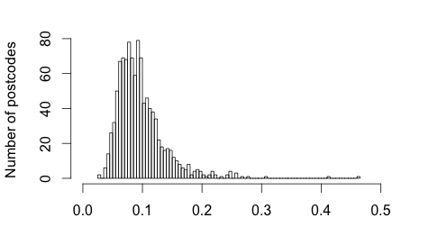
Extension – Data Visualisation
Notes:
nation_wide_rate: 0.08855657
Postcode level summary:
Min. :0.02658
1st Qu.:0.07015
Median :0.08930
Mean :0.09696
3rd Qu.:0.11298
Max. :0.46296

Slide 17
Extension - Models
Basic iid model
BYM model
SPC model not used.
INLA instead of MCMC for model generation
Notes:
We created two models, to allow us to make some comparisons between models.
Mikkel – please elaborate:
We created the basic iid model, which does not take geo-spatial neighbours into account.
We also created a BYM model, similar to the BYM model in the original paper.
We chose to not include the SPC model as our data did not contain zero counts. The SPC model is specifically designed for zero-count data by providing a second intercept to model this case. So this would actually be an unnecessarily complex and therefore worse model than the BYM for the immunisation data.
Mikkel – please elaborate on INLA vs MCMC

Slide 18
Extension – Results
All of our results on bit.do/VacAustralia
RRF – BYM
RRF – iid
UHExceedence – BYM
UHExceedence - iid
Notes:
The BYM and the iid model both identified the same clusters and were roughly similar, but the BYM model performed better (we will look at this more soon).

Slide 19
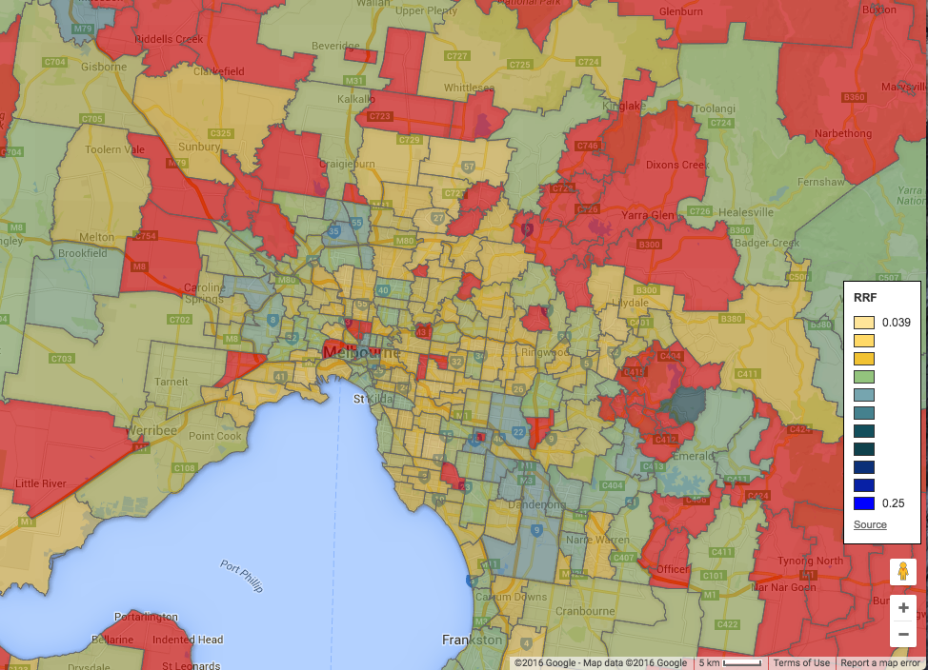
Extension - Results
Notes:
Here is an example of our mapping – this is a map of the relative risk factor for inner Melbourne postcodes. The red areas we don’t have data for. Yellow represents low relative risk – i.e. a high coverage of vaccination. Blue represents high relative risk. You can see there is possibly a cluster around Dandenong, but most of Melbourne has quite good coverage.

Slide 20
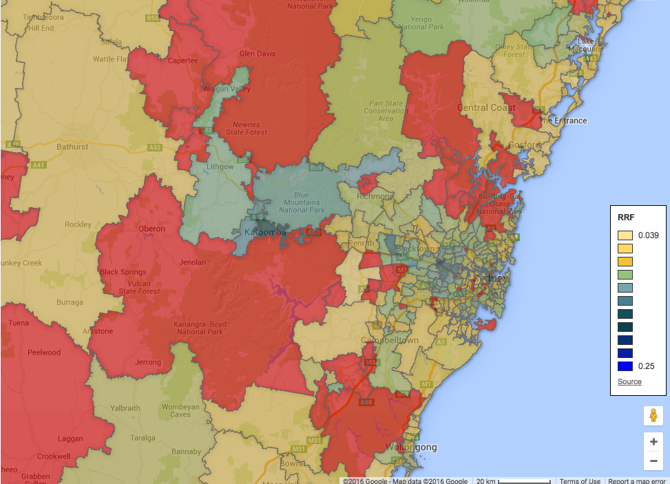
Extension - Results
Notes:
Map of outer Sydney – mapping relative risk factor. Clustering around Katoomba, Parramatta. Hotspot around Blacktown.

Slide 21
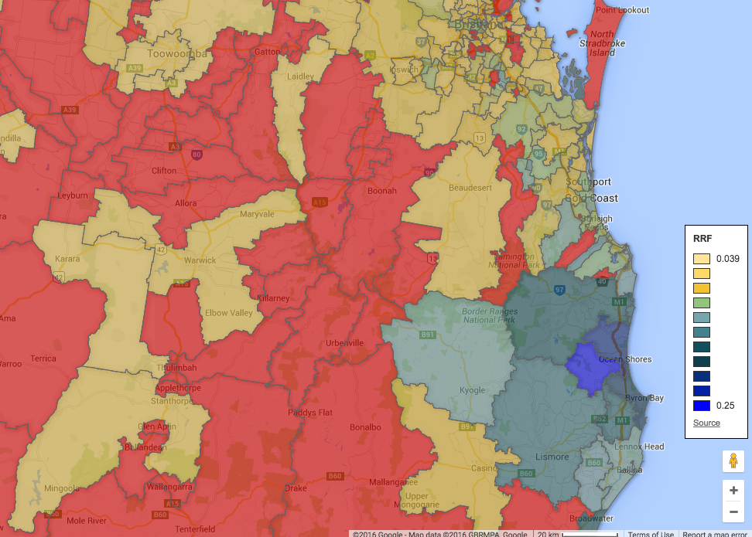
Extension - Results
Notes:
Other major clustering – Byron Bay and Lismore area. Perhaps the most serious cluster in Australia that we have data on. Also another cluster further south around Belligen and Coffs Harbour.

Slide 22
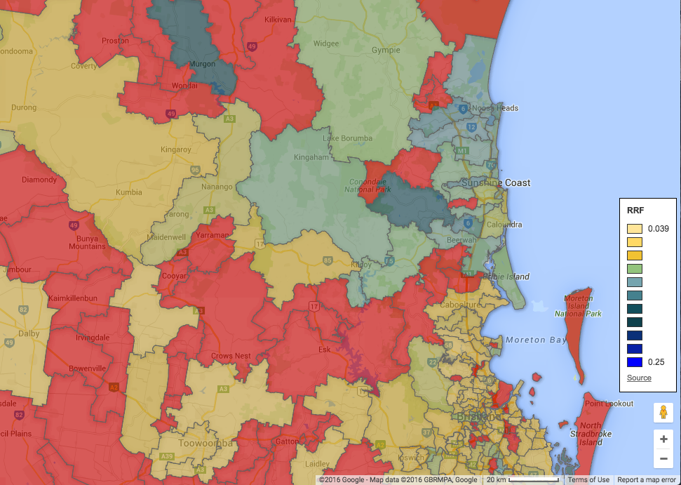
Extension - Results
Notes:
Other major clustering – Sunshine Coast Hinterland

Slide 23
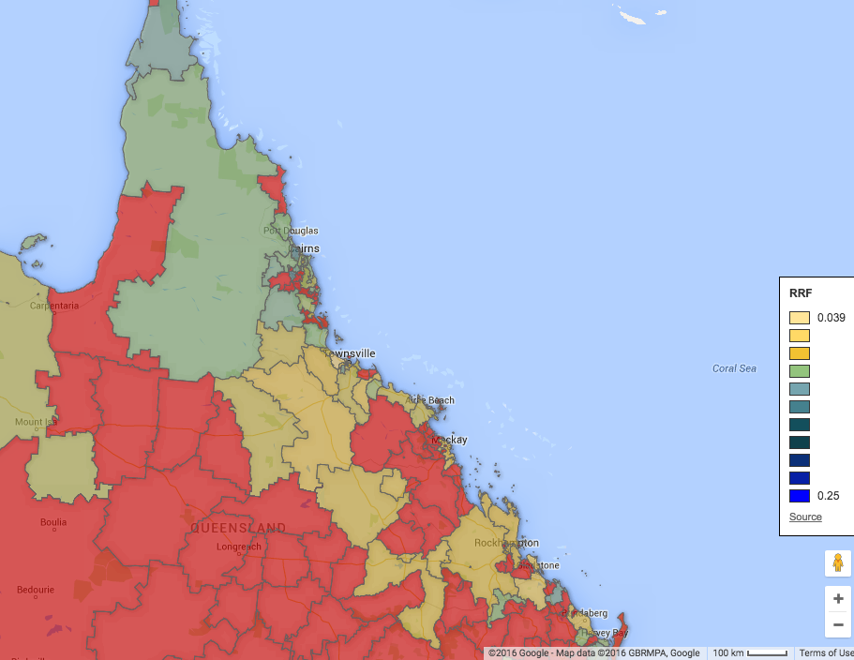
Extension - Results
Notes:
Further north, the immunisation rates decrease with a cluster around Cairns (not obvious on this map, you need to zoom in).

Slide 24
Extension – Comparisons between models
DIC and WAIC

Slide 25
Extension - Limitations
Large numbers of postal codes, data not published
Sparseness
The BYM model would be best for exactly the data that was not published
Notes:
We generally only had good data on the capital cities and the east coast.

Slide 26
Summary

Slide 27
References
To add:
Reference to paper in the heading
Reference to data for extension
References to motivation for immunisation

Slide 28
Questions?
Thank you!

